Slide 1

Customer Churn Prediction
Made By:- Jasroop Singh (18BCE10125)
Pratyush Sethi (18BCE10314)

Slide 2
What is churn?
Customer churn, also known as customer attrition, occurs when customers stop doing business with a company. The companies are interested in identifying segments of these customers because the price for acquiring a new customer is usually higher than retaining the old one.
For example, if Netflix knew a segment of customers who were at risk of churning they could proactively engage them with special offers instead of simply losing them.

Slide 3
Objective:-
The main objectives of our project are:-
To Analyze and pre-process the data
To visualize data using python
To build a predictive model for customer churn prediction using ML model

Slide 4
Framework of project
Our project can be divided into four parts:-
Pre-processing
Data Visualization
Predicting customer churn

Slide 5
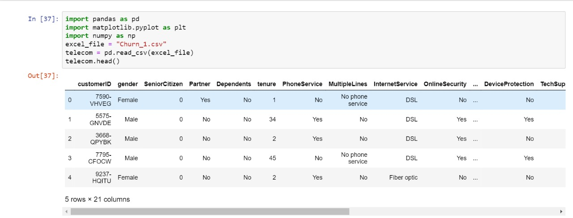
Pre-processing of data
In this step we are going to perform cleaning and filtering of data, then we will be applying feature selection and then feature extraction in order to make the final prediction accurate.

Slide 6
Data Visualization
It is the first part of our project in which we are going to analyze dataset for observing the relation between the attributes of the dataset by plotting graphs and cleaning and filtering the dataset in order to minimize the attributes and using only those attributes which effects the churn by eliminating the attributes which does not effect customer churn prediction.

Slide 7
Predicting customer churn
It is final part of our project in this we will be using linear regression which we will train on train dataset and then we will predict customer churn from test dataset.

Slide 8
Existing work
Pavan Raj a practitioner at Data Science in London, UK[1] has implemented a telecom customer churn prediction by considering all the attributes and by extracting there importance or weightage in predicting churn then have used logistic regression to predict customer churn for the attributes which have more weightage then have applied different prediction models for less weightage parameters.
Disadvantage:-
Lacking a creation of hypothesis which could help in reducing the computation and time required for the above approach as different algorithms has to be applied for different parts of data.

Slide 9
Proposed Work
Analyzing the dataset for feature selection with the help of python deep learning libraries like Pandas, matplotlib, etc.
Creation of hypothesis or determining major parameters which effect churn rate by visualizing data through graphs.
After the hypothesis has been confirmed to be valid we will train linear regression model to predict the customer churn.

Slide 10
Overall system architecture diagram
Dataset
Model training
Data cleaning and pre-processing
(Feature Engineering)
Evaluating Model
Visualizing the data
(Classification)
Creation of Hypothesis & Testing of hypothesis

Slide 11
Real Time Usage
Since, the retailers and organizations need strategies to increase their customer retention period, so this type of model for prediction saves time by analyzing or making them aware about the customers at risk of churn so that they can form some marketing strategies to stop them from churning.
This also helps the company to improve their services by understanding the reason or cause for the customers at risk of churn thus enhancing efficiency of the company.

Slide 12
Hardware and Software Requirements
Hardware:-
There are no such exceptionally different hardware requirements.
Software:-
The software required is python with deep learning libraries installed like pandas, Matplotlib, etc.
Excel support is required for the dataset as it is in excel format.

Slide 13
References
Pavan Raj, practitioner at Data Science in London
URL:https://www.kaggle.com/pavanraj159
Python deep learning libraries documentation, ex- pandas, matplotlib, etc.
Books:-
Data Science and Big Data Analytics by EMC Education, Data Smart by John W Foreman, etc.

